Slide 1
SHOCK & PRESSORS
Dr H

Slide 2
FIRST RULE
RESUSCITATE THE PATIENT

Slide 3
SECOND RULE
TREAT THE PATIENT
Maximal Dosing is Arbitrary
Patients often have multiple types of shock at play
-For example, a septic patient will have vasodilatory shock and possibly cardiogenic from cytokine-induced cardiomyopathy
-Consider multiple types of pressors if your evaluation warrants such

Slide 4
What Is Blood Pressure?
Function of:
HR
CO Myocardial contractility
SV Preload
Afterload
SVR
(GOAL MAP >60/65)

Slide 5
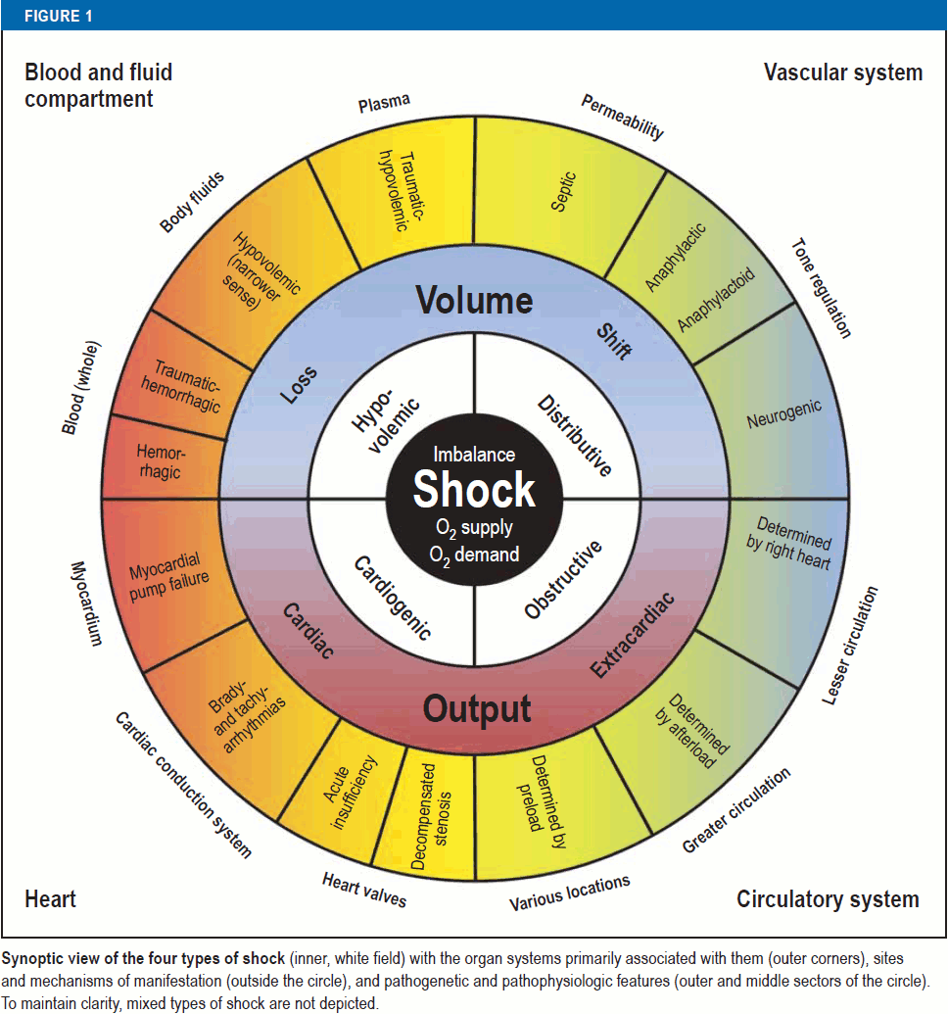
Types of Shock
Standl et al. The Nomenclature, Definition and Distinction of Types of Shock. Dtsch Arztebl Int 2018; 115: 757-68.

Slide 6
Hypovolemic Shock
Hypovolemic without Hemorrhage
Crystalloids
Hemorrhage
Blood Products
Traumatic Hemorrhage
Control bleeding
Blood Products
Norepinephrine if needed

Slide 7
Distributive
Loss of regulation of vascular tone
volume being shifted within the vascular system
disordered permeability of the vascular system
shifting of intravascular volume into the interstitium

Slide 8
Septic dysregulated response to infection
Antibiotics (EARLY)
Crystalloids (30mL/kg bolus)
Goal MAP >65
Norepinephrine
Vasopression "as a norepinephrine sparing measure"

Slide 9
Anaphylactic massive histamine-mediated vasodilation
Epineprhine (sometimes norepinephrine gtt)
Steroids (will take about 6 hours to fully kick in)
Anti-histamines (diphenhydramine & famotidine)
Crystalloids

Slide 10
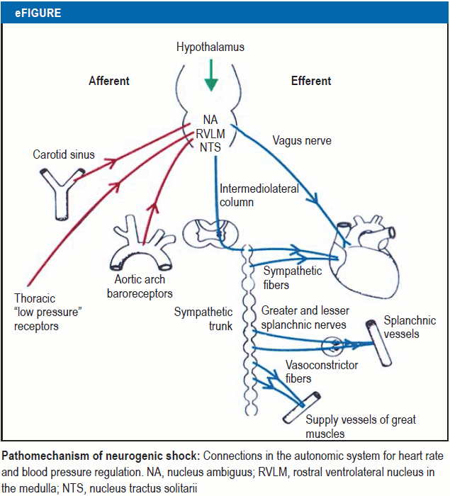
Neurogenic imbalance between sympathetic and parasympathetic regulation of cardiac action and vascular smooth muscle
Standl et al. The Nomenclature, Definition and Distinction of Types of Shock. Dtsch Arztebl Int 2018; 115: 757-68.

Slide 11
Neurogenic
Crystalloids
Goal MAP >85
Norepinephrine
Mineralcorticoids

Slide 12
Cardiogenic
May be due to myocardial, rhythmologic, or mechanical causes
Treatment clearly depends on cause
May include
Reperfusion
Pacemaker Placement
Valve Repair
Ablation
Balloon Pump
Ventricular Device Placement
Drugs: pressors, inotropes, calcium sensitizers, PDE3i

Slide 13
Obstructive obstruction of the great vessels or the heart itself
Treat Underlying Cause
Vena Caval Compression
Tension Pneumothroax
Pericardial Tamponade
PE
Intracardial Mass

Slide 14
A Word On Dosing
Hospitals will vary on WB (weight based) and NWB (nonweight based) dosing
Studies have identified that morbidly obese patients likely don't require weightbased doses
Given the arbitrariness of maximal dosing, simply be familiar with your hospital protocols
For example, even the FDA has no "upper limit" for norepinephrine. They simply state: "In all cases, dosage of LEVOPHED should be titrated according to the response of the patient. Occasionally much larger or even enormous daily doses (as high as 68 mg base or 17 vials) may be necessary if the patient remains hypotensive"

Slide 15
Receptors
Dopamine (DA1 & DA2)
Complicated actions within coronary, mesenteric & renal beds
Alpha (α1-adrenergic)
Arterial vasoconstriction
Ubiquitous within smooth muscle of arterial walls
Beta (β1-adrenergic)
Increased cardiac contractility and heart rate
Cardiac smooth muscle
acting on sinoatrial node to produce chronotropy
acting on atrial&ventricular muscle to produce inotropy
Vasopressin (V1)
Vasoconstriction, ADH/Prolactic Release, Renal Water Reabsorption
Lie within vascular smooth muscle, ant pituitary, and renal collecting duct

Slide 16
Drugs WB
Norepinephrine
Start @ 0.2 mcg/kg/min max 3 mcg/kg/min
Epinephrine
Start @ 0.1 mcg/kg/min max 1.0 mcg/kg/min
Vasopressin
0.04 units/min (on or off, no titration)
Phenylephrine
Start @ 0.5 mcg/kg/min max 10 mcg/kg/min
Dopamine
Start @ 5mcg/kg/min max 20 mcg/kg/min
Dobutamine
Start @ 2.5 mcg/kg/min max 20 mcg/kg/min
40mcg/kg/min used in stress tests

Slide 17
Drugs NWB
Norepinephrine
Start @ 5 mcg/min max 30-40 mcg/min
Epinephrine
Start @ 5 mcg/min max 40 mcg/min
Vasopressin
0.04 units/min (on or off, no titration)
Phenylephrine
Start @ 40 mcg/min max 200 mcg/min
Dopamine & Dobutamine are not usually dosed in a NWB format

Slide 18
Norepinephrine
1ST CHOICE GTT in ALL TYPES OF SHOCK
Increased SVR; little or no change in CO
Combined α and β (α > β)
Start @ 0.2 mcg/kg/min max 3 mcg/kg/min
5 mcg/min max 30-40 mcg/min
Excessive peripheral vasoconstriction can lead to lactic acidosis, ischemia/necrosis

Slide 19
Epinephrine
ANAPHYLACTIC
Increases SV and CI, modest increases in SVR & HR
Combined α and β
Start @ 0.1 mcg/kg/min max 1.0 mcg/kg/min
5 mcg/min max 40 mcg/min
Excessive peripheral vasoconstriction can lead to lactic acidosis, ischemia/necrosis

Slide 20
Vasopressin
ADD TO NOREPINEPHRINE IN SEPTIC SHOCK
Endogenous hormone from posterior pituitary
Deficiency in septic shock
Dose: 0.01 – 0.06 units/min
V₁ receptors on vascular smooth muscle = vasoconstriction

Slide 21
Phenylephrine
Good for pts in which other drugs’ SE profile, i.e. tachyarrthymias, limits their use
Pure α₁
Increased SVR
Start @ 0.5 mcg/kg/min max 10 mcg/kg/min
40 mcg/min max 200 mcg/min
Excessive peripheral vasoconstriction can lead to lactic acidosis, ischemia/necrosis
Careful use in cardiac patients – increase in SVR & MAP without change in HR leads to decreased CO and will cause coronary vasoconstriction

Slide 22
A Word on Extravasation
IMPORTANT — Antidote for Extravasation Ischemia: To prevent sloughing and necrosis in areas in which extravasation has taken place, the area should be infiltrated as soon as possible with 10 mL to 15 mL of saline solution containing from 5 mg to 10 mg of Regitine® (brand of phentolamine), an adrenergic blocking agent. A syringe with a fine hypodermic needle should be used, with the solution being infiltrated liberally throughout the area, which is easily identified by its cold, hard, and pallid appearance. Sympathetic blockade with phentolamine causes immediate and conspicuous local hyperemic changes if the area is infiltrated within 12 hours. Therefore, phentolamine should be given as soon as possible after the extravasation is noted

Slide 23
Dopamine
CONSIDER IF THERE IS NEED FOR INOTROPIC SUPPORT
↑ Stroke Volume (thereby ↑ MAP & CO)
Dose-related receptor activity “Renal dose dopamine” doesn’t exist
DA: 1-3 mcg/kg/min
β₁: 3-10 mcg/kg/min
α₁: 10-20 mcg/kg/min
Major SE: Tachyarrhythmias
Other SE: Increase in PCWP and pulmonary shunting, May cause poor splanchnic perfusion

Slide 24
Dobutamine
NEED FOR INTOTROPE
β₁ – strong inotropic activity
Increased contractility leads to decreased SVR (sometimes called “inodilator”) - will often need to use with norepinephrine
Start @ 2.5 mcg/kg/min max 20 mcg/kg/min
SE: Tachydysrhythmias
Isoproterenol is a pure beta-agonist and a powerful chronotrope dosed at 2-10mcg/min - many hospitals don't carry it

Slide 25
Midodrine
"Oral Phenylephrine"
Used in OP setting particularly for pts who develop hypotension with dialysis
Can be used in the hospital to liberate from IV vasopressors
Is a component of therapy for hepatorenal syndrome

Slide 26
Miscellaneous Drugs
Methylene Blue 1.5 to 2 mg/kg over 20 to 60 minutes administered once
Restore Vasoplegia after Cardiac Surgery (through eNOS)
Milrinone 0.375-0.75 mcg/kg/min
PDE3i increasing cAMP
Causes increased myocardial contractility & vasodilation
Levosimendan 6 to 12 mcg/kg infused over 10 minutes. Maintenance: 0.05 to 0.2 mcg/kg/minute
"Calcium Sensitizer"
Enhances ventricular contractility & vasodilation
Angiotensin II 10 to 80 ng/kg/minute
Works at AT1 and AT2 G-coupled protein receptors to vasoconstrict and release aldosterone and vasopressin

